Slide 1
By Lucy Mbugua
Dalila

Slide 2
Product Goals and Relevant Elements
The goals:
There are certain preset parameters that should met in both the backend and the front-end.
This presentation aims to show my understanding of user centered design, accessibility considerations and portray my technical skills.
The elements relevant to my role:
The overall layout website design – by breaking down pages and what each page should contain.
The product listing requirements design.
The design of the filter

Slide 3
Project execution steps
There were four steps planned for execution:
User Research
Refining the design
Testing the design
Front-end implementation

Slide 4
User research
Project execution

Slide 5
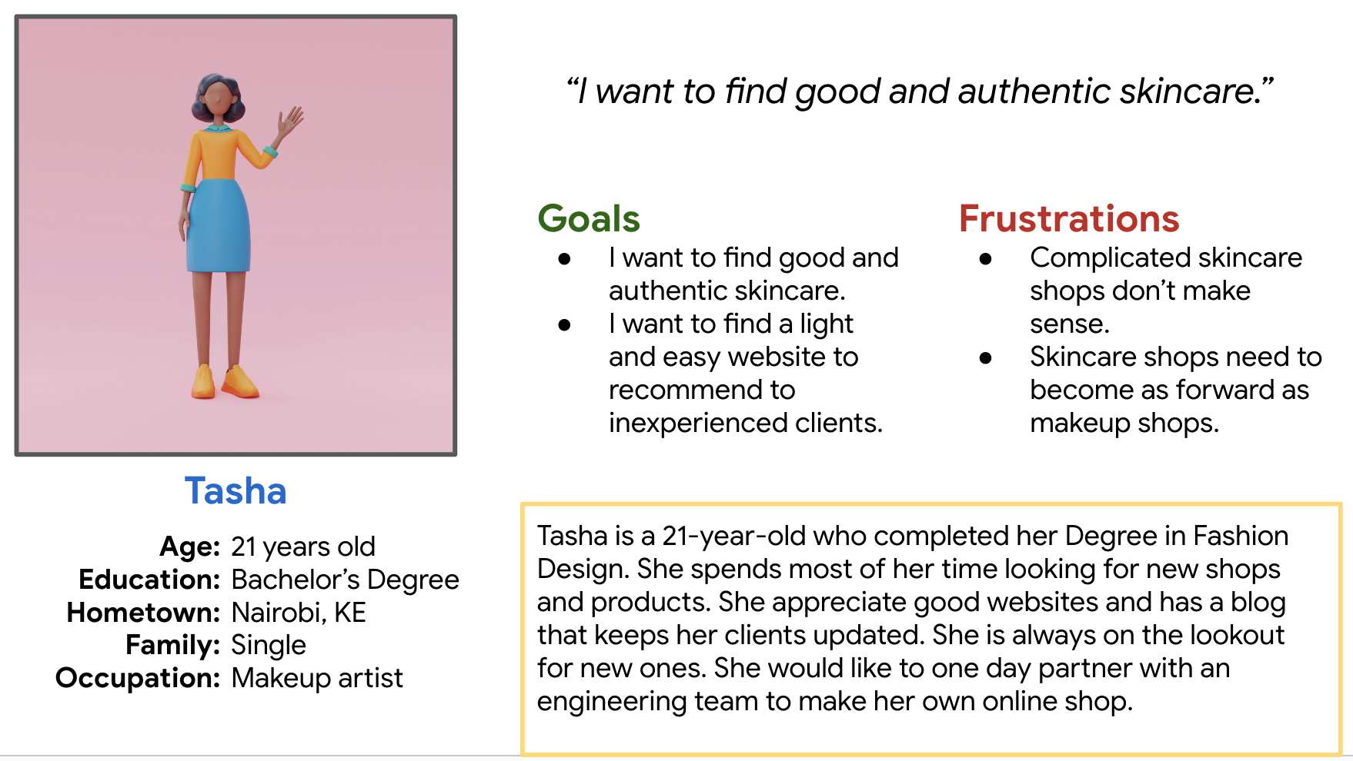
Persona: Tasha

Slide 6
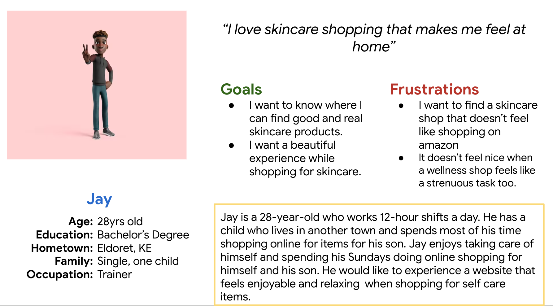
Persona: Jay

Slide 7
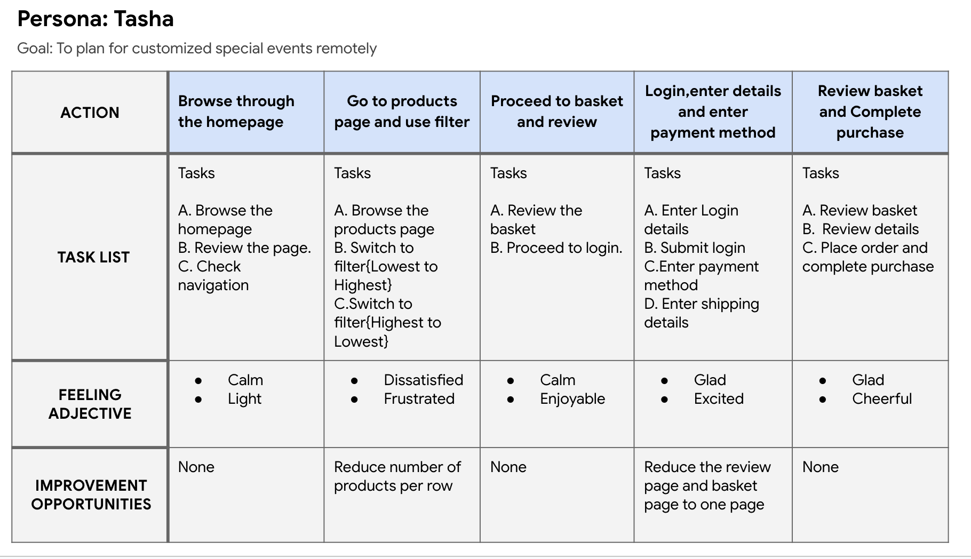
User journey map

Slide 8
High fidelity mockups
Refining the design

Slide 9
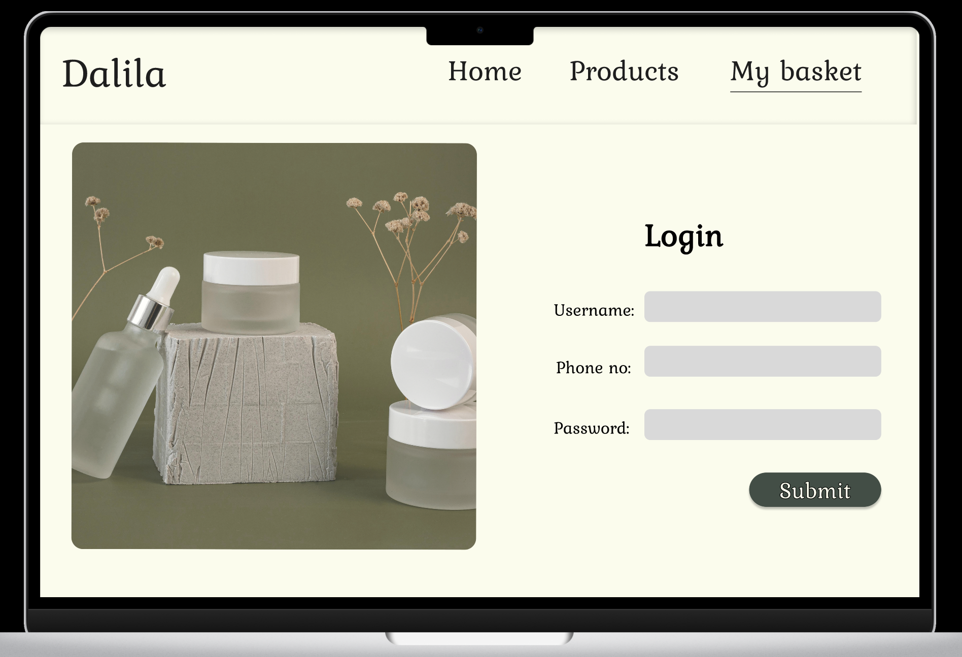
Mockups
This is a preview of the login page. Here’s the link to the prototype.
Here is the link to the flow of the prototype.

Slide 10
Accessibility Considerations
The texture added to the menu and the buttons are to aid people with limited sight, incase the colours don’t portray the hierarchy and call to action elements.
The addition of icons and a consistent navbar for easy navigation especially for non-English speakers.

Slide 11
Usability study
Testing the design

Slide 12
Usability study takeaways
Impact:
The user enjoyed the experience and compared the experience to be as relaxing as booking a spa day.
The website was easy to use and navigate.
What I learned:
The user mentioned that the pages needed more filters and a place to contact the shop.
Future iterations should include a product description pop up or page.

Slide 13
Next steps
Test the design with other potential end users. Find out their thoughts on the website.
Gain insights and re-work the designs.
Design for future iterations.

Slide 14
Let’s connect!
Thank you for reviewing my work on Dalila . If you would like to get in touch and/or see more of
my work, you can contact me on the email below and checkout my portfolio.
Email: lmbugua63.lm@gmail.com
Portfolio: portfolio-lucywambui.vercel.app/

